Slide 1
Experiential Learning Phase -I :
Network Traffic Classification using Machine Learning
BY:
KUSHAL R U– 1RV22CS093
MANOJ KUMAR B V– 1RV23CS407
MOHAMMED ADNAN – 1RV23CS409
NAGAPRASAD NAIK– 1RV23CS410

Slide 2
PROBLEM STATEMENT
•The increasing complexity and volume of network traffic pose significant challenges for network management and security.
•Efficiently classifying network traffic is crucial for optimizing network performance, ensuring security, and managing bandwidth.
• Network Traffic Classification is the first step to analyze and identify different types of applications flowing in a network. Through this technique, internet service providers or network operators can manage the overall performance of a network.

Slide 3
INTRODUCTION
•The traditional technique to classify internet traffic like Port Based, and Payload Based.
•Network Traffic Classification plays a very vital role in network security and management, such as Intrusion Detection, Quality of Service (QoS). Through this technique, network operators can take some actions such as to block some flows and manage resources.

Slide 4
Summary of Traffic Classification Approaches
 | Description | Advantages | Disadvantages
Port-Based Methods | Classify Packets by port numbers | Fast Low resource consuming High accuracy | Does not implement the application layer payload, so it does not compromise the user’s privacy. Infeasible for hidden ports
Payload-Based Methods | Generally, use deep packet inspection to look into packet contents | Handle services with dynamic ports | High computational cost Inapplicable for encrypted data and privacy issues
ML-Based Methods | Extract Features from packet payload or statistical characteristics with an ML Model | Handle dynamic port and encrypted data Fast technique compared to Payload-based Methods | Longer classification time compared with port-based method

Slide 5
OBJECTIVES
•To implement and evaluate multiple machine learning algorithms for network traffic classification.
•To compare the performance of these algorithms in terms of accuracy, precision, recall, and F1-score.
•To identify the most effective algorithm for classifying various types of network traffic.
•To analyze the importance of features and address class imbalance issues.

Slide 6
LITERATURE REVIEW
Paper Title, Author & Publication | Summary | Merits | Demerits | Methodology
Network Traffic Classification Techniques and Comparative Analysis using Machine Learning Algorithms Muhammad Shafiq, Xiangzhan Yu, Asif Ali Laghari, Lu Yao, N abin Kumar Karn, F oudil 2016, 2nd IEEE International Conference on Computer and Communications | The paper reviews network traffic classification techniques: Port-Based, Payload-Based, and Machine Learning-Based. It highlights the limitations of traditional methods and advocates for machine learning. A comparative analysis of C4.5, SVM, BayesNet, and Naive Bayes classifiers shows that C4.5 achieves the highest accuracy in classifying WWW, DNS, FTP, P2P, and Telnet traffic. | Thorough analysis of multiple machine learning classifiers with real-world data. Demonstrates that C4.5 decision tree offers better accuracy than others. | Limited to a small number of classifiers and network traffic types. The study does not address the impact of newer encryption methods on traffic classification. | Data was captured using Wireshark and features were extracted using NetMate. Four machine learning classifiers were applied, and their performance was compared based on accuracy, recall, and precision. C4.5 was found to be the most accurate

Slide 7
A Comparative Performance Analysis on Network Traffic Classification using Supervised Learning Algorithms Archanaa R, T. Rajasundari, V. Athulya, Vamsee Krishna Kiran M International Conference on Advanced Computing and Communication Systems (ICACCS -2017) | The paper compares supervised learning algorithms—Ensemble methods, Trees, and Bayes classifiers—for network traffic classification. Using a wrapper method for feature selection, it finds the Decorate algorithm from the Ensemble methods performs best, evaluated by accuracy, precision, recall, and ROC area metrics. | Comprehensive comparison of different supervised learning algorithms. Decorate algorithm's superior performance is highlighted. ex: Bagging , Boosting, Stacking. | The paper does not delve into deep learning methods or consider the effect of emerging network protocols. | The study employed a wrapper method for feature selection and evaluated multiple supervised learning algorithms based on accuracy, precision, recall, and ROC area. Decorate algorithm showed the best performance.

Slide 8
Network Traffic Classification using Deep Neural Networks Muhammad Shaheem Raza, Kamran Aziz Bhatti, Fahad Mumtaz Malik and Shahzad Amin Sheikh International Conference on Frontiers of Information Technology (FIT) | The paper explores deep neural networks (DNNs) for network traffic classification, focusing on CNN, RNN, and hybrid approaches. It highlights DNNs' effectiveness in handling encrypted traffic and achieving high accuracy. The study finds that a CNN-LSTM-NN combination performs best, with 96% accuracy on the RedIRIS dataset. | High accuracy in classifying encrypted network traffic using DNNs. Evaluation of multiple DNN architectures for traffic classification. | The study is limited to neural network methods, with no comparison to traditional machine learning algorithms. | The authors evaluated CNN, RNN, and hybrid architectures on the RedIRIS dataset. The CNN-LSTM-NN combination was identified as the most effective, achieving 96% accuracy. The study focused on handling encrypted traffic.

Slide 9
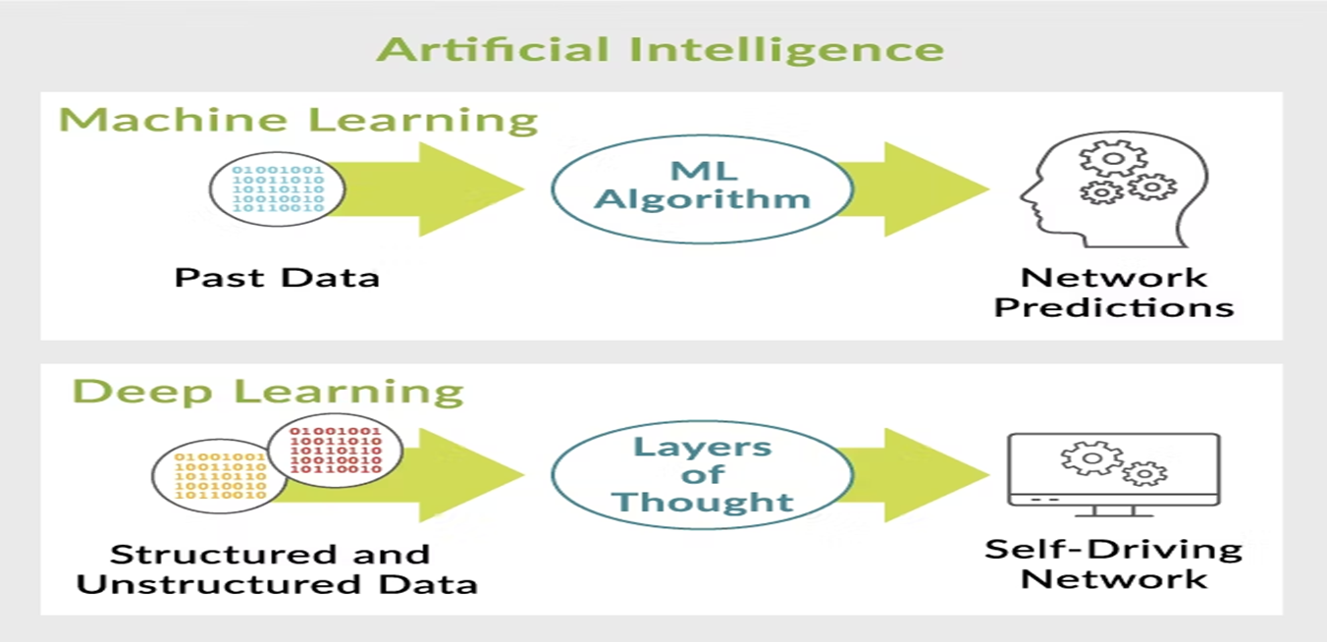
METHODOLOGY

Slide 10
METHODOLOGY
•Data Preparation: The captured network trace data is pre-processed to format it for machine learning models. This involves cleaning the data, extracting relevant features, and splitting it into training and testing sets.
•Model Building: Machine learning algorithms are implemented using Python libraries such as scikit-learn or TensorFlow. The model is trained on the dataset to classify network protocols based on the features extracted from the traces. “Source, Destination, Time, Length”.
•Evaluation: The performance of the machine learning models is evaluated using metrics such as accuracy, precision, recall, and F1 score. The results are analyzed to determine the effectiveness of the protocol classification.
•Classification Performance: The results of the protocol classification are assessed to determine how well the machine learning models perform. This analysis helps in understanding the strengths and limitations of the models in identifying and classifying network protocols.
Optimization and Improvements: Based on the evaluation, further refinements and optimizations may be applied to improve model performance and enhance the accuracy of protocol classification.

Slide 11
CONCLUSION
We focused on understanding the integration of network traffic classification with machine learning. This foundational phase involved researching various machine learning algorithms such as decision trees, random forests, and neural networks, to evaluate their effectiveness in classifying network traffic. Overall, this initial has established a solid groundwork for the project's future stages, where we will focus on applying and fine-tuning machine learning models to enhance network performance and security.

